Slide 1

PROJECT WORK IN MACHINE LEARNING CREDIT CARD FRAUD DETECTION
Professor
Claudio Sartori
Presented By
Yellam Naidu Kottavalasa
Matricola: 0000985387

Slide 2
ABSTRACT
It is vital that credit card companies can identify fraudulent credit card transactions.
Customers are not charged for items that they did not purchase.
This problems can be tackled with Data Science and its importance, along with Machine Learning.
Credit Card Fraud Detection is a typical sample of classification.

Slide 3
CONTENTS
Introduction
Project Pipeline
Data Collection
Analyzing Data
Preprocessing
Model Creation
Evaluation of Models
Conclusion

Slide 4
INTRODUCTION
Protect against similar occurrences in the future.
Fraud detection involves monitoring the activities of populations of users in order to estimate, perceive or avoid objectionable behavior, which consists of fraud, and defaulting.
Necessary prevention measures can be taken.
Unauthorized and unwanted usage of an account.

Slide 5
Project Pipeline
Data Collection
Analyzing Data
Univariate Analysis
Bivariate Analysis
Data Preprocessing
Model Creation
Logistic Regression
Decision Tree
Random Forest
Evaluation Of Models
Accuracy
Precision
Recall
Confusion Matrix

Slide 6
Data Collection
Data collection is the systematic approach.
Gathering and measuring information from a variety of sources.
Containing 1,296,675 transactions of both legitimate and fraud transactions.
It covers credit cards of 1000 customers.
a pool of 800 merchants.
Test
Train

Slide 7
Analyzing Data
Process of inspecting, transforming, and modeling data.
Discovering useful information.
Here the data can be visualized in two ways. They are
Analyzing Data
Univariate Analysis
Bivariate Analysis
Univariate Analysis
Bivariate Analysis

Slide 8
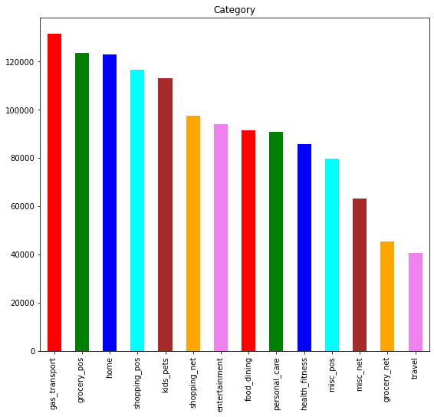
Univariate
Analysis
To enumerative properties as well as a descriptive summary.
gas_transport of the category done the highest credit card transactions.
travel of the category done the lowest credit card transactions.

Slide 9
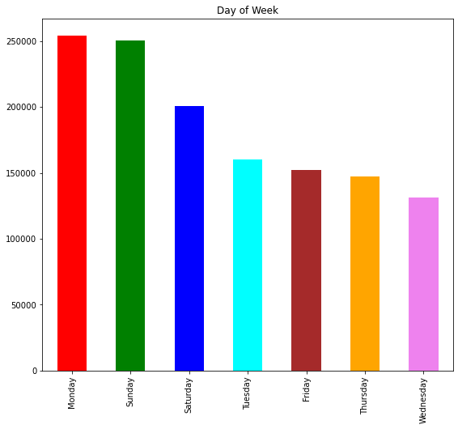
Sunday and Monday of the week have highest credit card transactions.
Wednesday of the week have the lowest credit card transactions.

Slide 10
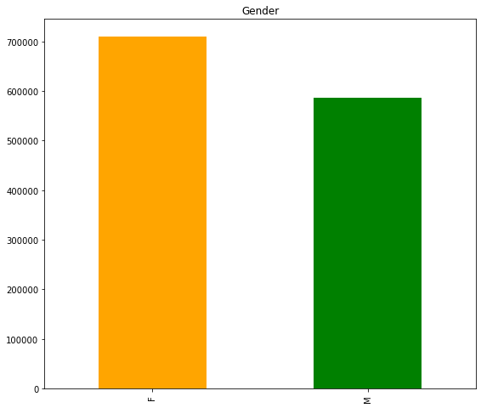
Females are done the more Credit card transactions compared to Male.

Slide 11
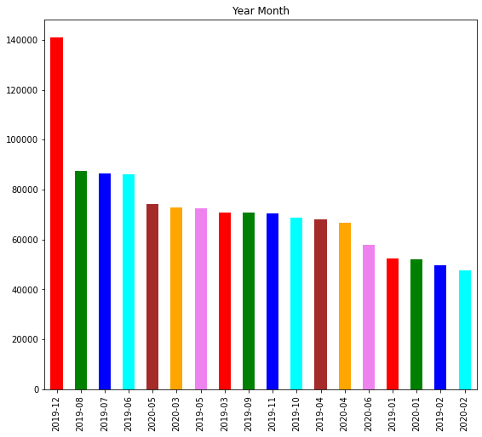
Highest number of transactions are in the month of December 2019 year.
Lowest number of transactions happens in February month of 2020 year.

Slide 12
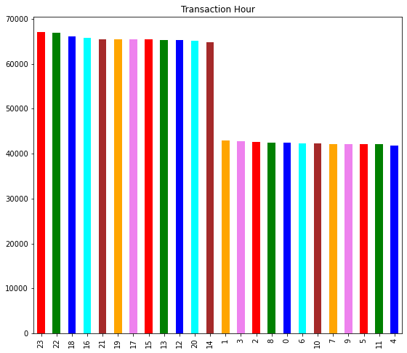
Most of the transactions are happened at night 11'O clock.
Less number of transactions are happened at evening 4'O clock.

Slide 13
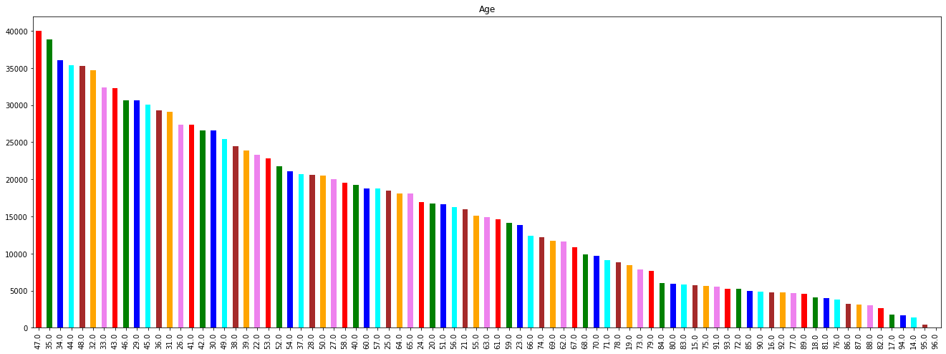
Highest number of transactions are done by the 47 years age people.
Lowest number of transactions are done by the 96 years age people.

Slide 14
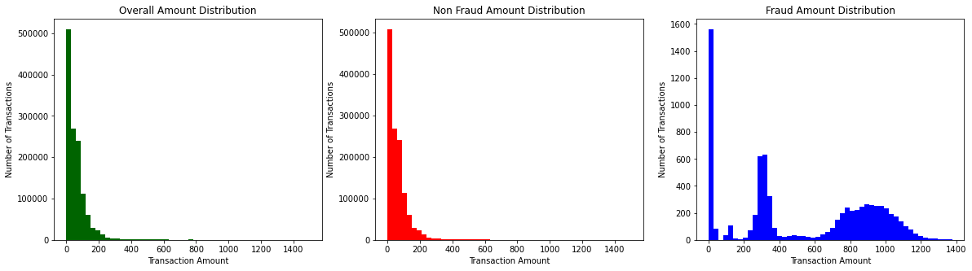
Kind of empirical relationship between two variables.
Specifically, the dependent vs independent Variables.
Bivariate Analysis

Slide 15
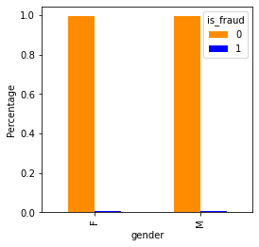
Same number of male and female candidates done the fraud transactions.

Slide 16
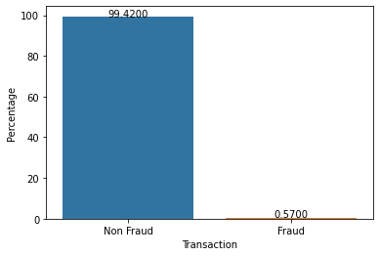
99.42% of people are not done the fraud transactions.
0.57% of the people are done the fraud transactions.

Slide 17
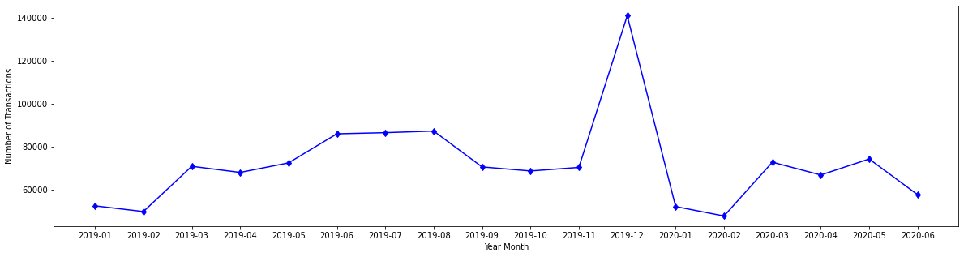
Project analysis slide 4
More number of transactions are in the December month of 2019 and the lowest transactions in February month of 2020.
Notes:
17

Slide 18
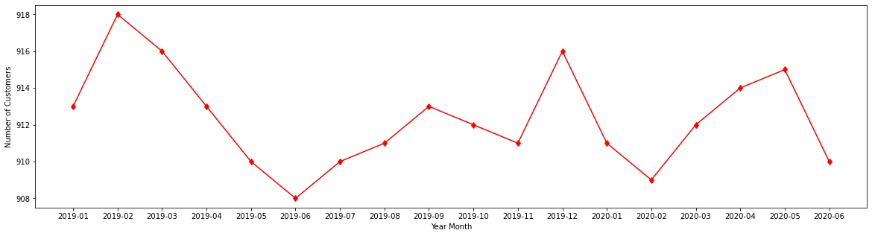
More number of customers are in the February month of 2019 and the lowest number of customers in June month of 2019.

Slide 19
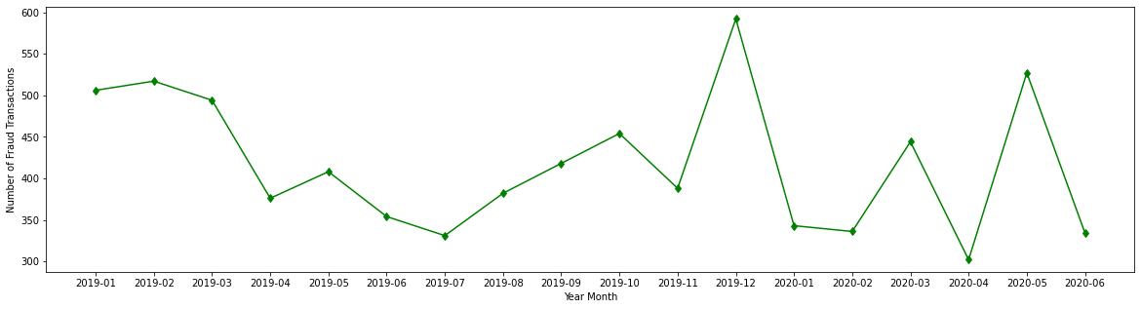
More number of fraud transactions are in the December month of 2019 and the lowest fraud transactions in April month of 2020.

Slide 20



Data Preprocessing
Data normalization is applied to some features.
To make model training less sensitive to the scale of features.
one-hot encoding can be applied to the integer representation
new binary variable is added for each unique integer value.
The Dataset is highly imbalanced
Oversampling involves randomly selecting examples from the minority class, with replacement, and adding them to the training dataset.

Slide 21
Project analysis slide 8
Model Creation
we can try different models.
Desired level of performance on the given dataset.
1. Logistic Regression
2. Decision Trees Classification
3. Random Forest Classification
Notes:
21

Slide 22
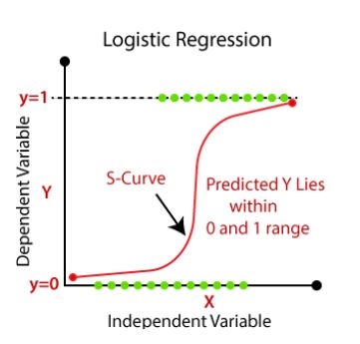
Logistic Regression
Logistic regression is a supervised learning classification algorithm
Predict the probability of a target variable.
Two possible classes.
Relationship between one dependent binary variable and one independent binary variable

Slide 23
Accuracy: 0.92
Precision for 0 class: 0.92
Precision for 1 class: 0.75
Recall for 0 class: 1.00
Recall for 1 class: 0.05
F1 score for 0 class: 0.96
F1 score for 1 class: 0.09
Evaluation of Logistic Regression Model

Slide 24

Decision Tree Classification
Supervised learning technique
Both classification and Regression problems.
Preferred for solving Classification problems.
It is a tree-structured classifier
Internal nodes represent the features of a dataset, branches represent the decision rules, and each leaf node represents the outcome.

Slide 25
Evaluation of Decision Tree Classification Model
Accuracy: 0.96
Precision for 0 class: 0.97
Precision for 1 class: 0.97
Recall for 0 class: 1.00
Recall for 1 class: 0.14
F1 score for 0 class: 0.98
F1 score for 1 class: 0.25

Slide 26
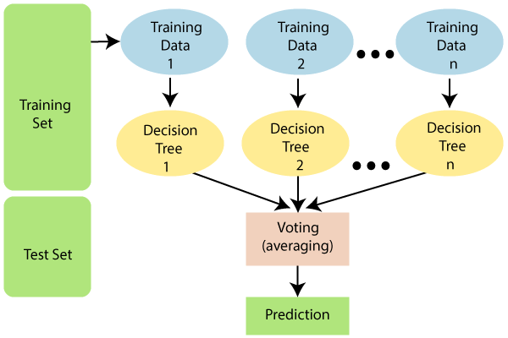
Random Forest Classifier
Supervised learning algorithm.
Most flexible and
Easy to use algorithm.
Creates decision trees on randomly selected data samples, gets prediction from each tree.
selects the best solution by means of voting.

Slide 27
Evaluation of Random Forest Classification Model
Accuracy: 0.97
Precision for 0 class: 0.97
Precision for 1 class: 0.85
Recall for 0 class: 1.00
Recall for 1 class: 0.14
F1 score for 0 class: 0.98
F1 score for 1 class: 0.24

Slide 28
CONCLUSION
An act of criminal dishonesty.
the machine learning can be applied to get better results in fraud detection.
Best Performer - Random forest Classification gives the highest accuracy is 97.03%
Worst Performer – Logistic Regression Model.

Slide 29
Thank You

